Slide 1
Semester Project of CYBR8480
HealthCare Mobile App
Presenter: Zexi
Instructor: Dr. Hale

Slide 2
Project Summary
Thanks for technology, the contemporary people's life become very convenient and efficient. With relying on modern technologies, people's health is gradually decreasing. Due to lack of exercise, all kinds of diseases jump into people life.
Therefore, in this project, I would like to develop a kind of healthy app to help people increase their health condition and raise attention of the importance of fitness..

Slide 3
Project Goals
Develop User authentication mechanism: provide an app user interface to allow our user to interact with our customer service.
Embed Heart rate measurement: measure user’s instant heart rate
Combine Video demo of exercise with app: video list to let user access their preferred video demo
GPS service and Distance calculator: offer a trail calculator and real time location sharing
Fitness data recorder: a memorandum to record all the users' working out status

Slide 4
User case analysis
User stories
As a busy employee who has to do extra work after the normal working time, I want increase my health condition by watching some professional video of indoor exercises with lower cost and spend less time, so that I will not stay in the suboptimal health condition or even protect myself from diseases.
As a fitness fanatic, I want to measure my heart rate after I have done intensive exercise in the gym without using a wearable detector, so that I will not working out too hard to cause me drained or injury.
As a cycling enthusiast, I want to calculate the mileage between two different locations and also know my current location at any time, so that I won't lose my way and get wrong direction to bicycle.

Slide 5
User case analysis Cont’d
Misuser stories
As a network eavesdropper who has experience on doing packets sniffing, I want to use some external tool to sniff user's personal information from HealthCare mobile app, so that I can use those users' info to blackmail them.
As an internet hacker who is a member in the dark web, I want to collect all of the user's health records and location information from HealthCare mobile app, so that I can sell those information to someone who would like to pay me in the dark web.

Slide 6
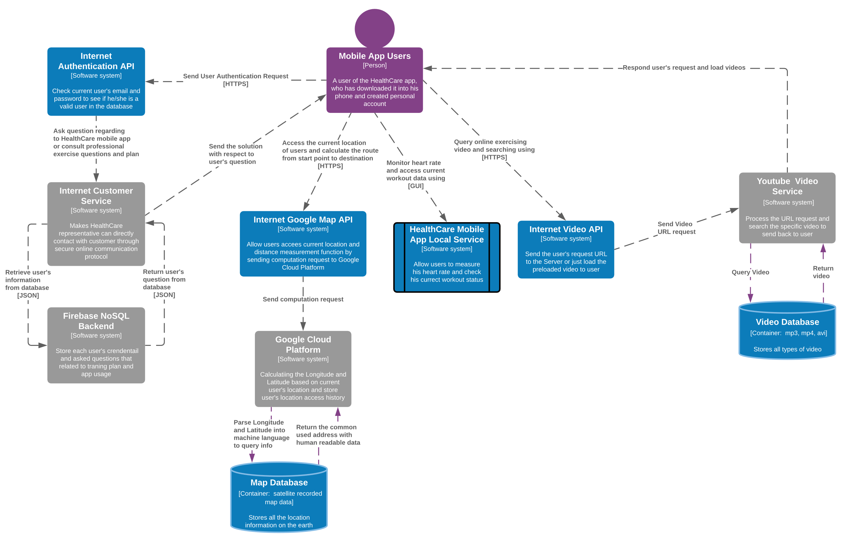
App Design

Slide 7
Component List
Authentication Component
User Login
User Register
NoSQL backend
Mobile Local Features
Hydration Recorder
Heart Rate Detector
Google Map Service
GPS Service
Distance Calculator
Online Video Service
Video Searching
Local Cached Videos

Slide 8
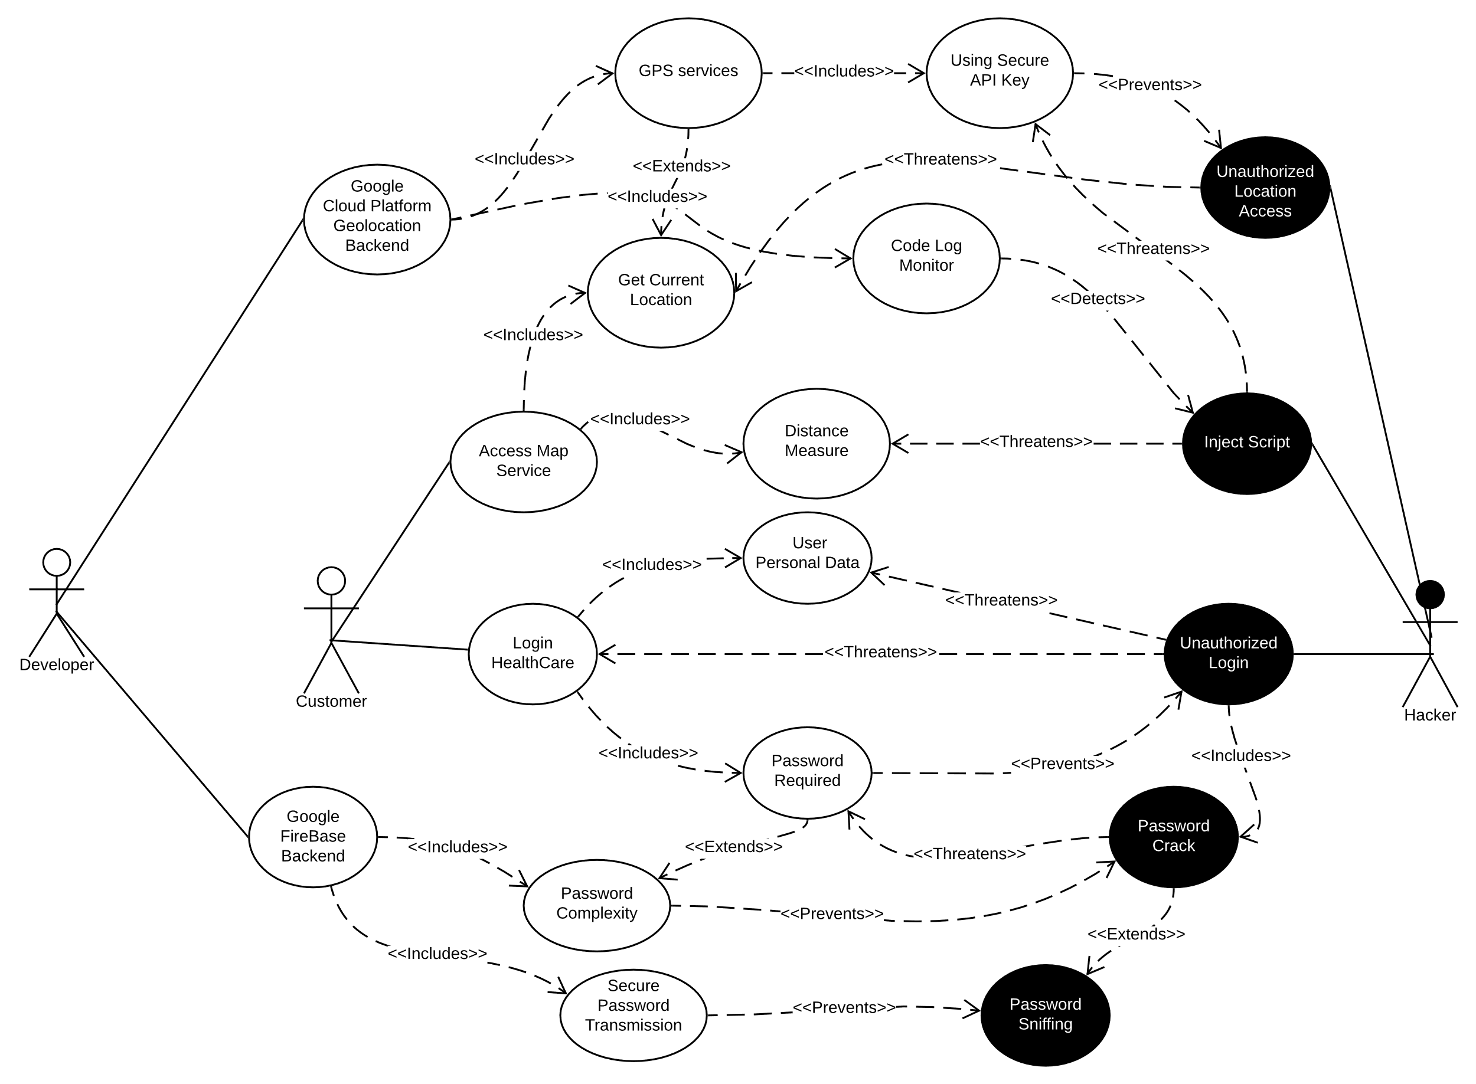
Security analysis

Slide 9
Implementation Video
Please visit the demo along this presentation at this link: https://app.vidgrid.com/view/tSy0JJZw5J3w

Slide 10
Testing
Test Function | Criteria | Test result | Need further modification
HeartRate | Tested the variable change and compare if it is equal to an expected value | correctly passed | Not required at this stage
Customer Service | Tested if a widget can be pumped and execute right login and logout status | correctly passed | Prefer to develop a chat windows between the customer and support services, also it is great to embed an AI representative while during the off time
Google GPS | Tested if wighets can retrieve the right data from cloud service and all widgets can be found | correctly passed | Adding keyword recommendation will be good for exercises to find a better destination to go
Video Service | Test if the YouTube video widgets, play button, and icon can be found by flutter tester | correctly passed | Can add more video features
Workout records | Test if those health records can be shown | correcly passed | Data can be dynamic for the next development phase and the layout can be changed to fit in multiple devices screen

Slide 11
Future Development
Set the authentication phase as the default page before using HealthCare’s function
Not just detect the heart rate, so it might can connect to other IoT device like earphone to improve the exercising experience
Make the customer support service interface more humanized
Include Google Map 3D vision, so user can select their preferred path

Slide 12

Question

